Slide 1
Intro to Cloud Computing CS4037 (BCS-6A) Lecture 16
Dept. of Computer Science
FAST School of Computing
NUCES Lahore

Slide 2
Module 8: Databases
AWS Academy Cloud Foundations

Slide 3
Section 2: Amazon DynamoDB
Module 8: Databases

Slide 4
Relational (Str.) versus non-relational (Semi-Str.) databases
 | Relational (SQL) | Non-Relational
Data Storage | Rows and columns | Key-value, document, graph
Schemas | Fixed | Dynamic
Querying | Uses SQL | Focuses on collection of documents
Scalability | Vertical | Horizontal
Example
ISBN | Title | Author | Format
3111111223439 | Withering Depths | Jackson, Mateo | Paperback
3122222223439 | Wily Willy | Wang, Xiulan | Ebook
{
ISBN: 3111111223439,
Title: “Withering Depths”,
Author: ”Jackson, Mateo”,
Format: “Paperback”
}

Slide 5

What is Amazon DynamoDB?
Fast and flexible NoSQL database service for any scale
NoSQL database tables
Virtually unlimited storage
Items can have differing attributes
Low-latency queries
Scalable read/write throughput
Amazon DynamoDB

Slide 6
Amazon DynamoDB core components
Tables, items, and attributes are the core DynamoDB components
A table is a collection of data.
Items are a group of attributes that is uniquely identifiable among all the other items.
Attributes are a fundamental data element, something that does not need to be broken down any further.
Friends, Items [Ali, Umar], Attribute [Name, Contact, Address]
DynamoDB supports two different kinds of primary keys: Partition key and partition and sort key

Slide 7
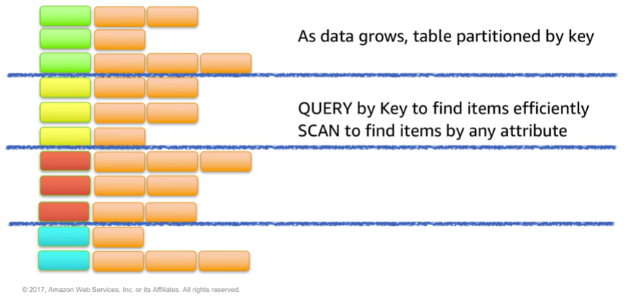
Partitioning

Slide 8
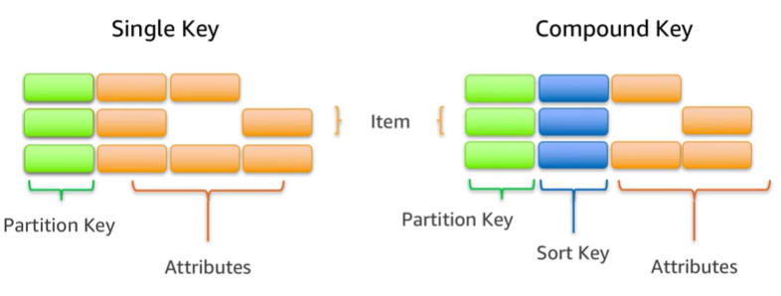
Items in a table must have a key
Notes:
Student: Student-Id Course-Allocation: Student-Id, Course-Id

Slide 9

Section 2 key takeaways
Amazon DynamoDB:
Runs exclusively on SSDs.
Supports document and key-value store models.
Replicates your tables automatically across your choice of AWS Regions.
Works well for mobile, web, gaming, adtech, and Internet of Things (IoT) applications.
Is accessible via the console, the AWS CLI, and API calls.
Provides consistent, single-digit millisecond latency at any scale.
Has no limits on table size or throughput.

Slide 10
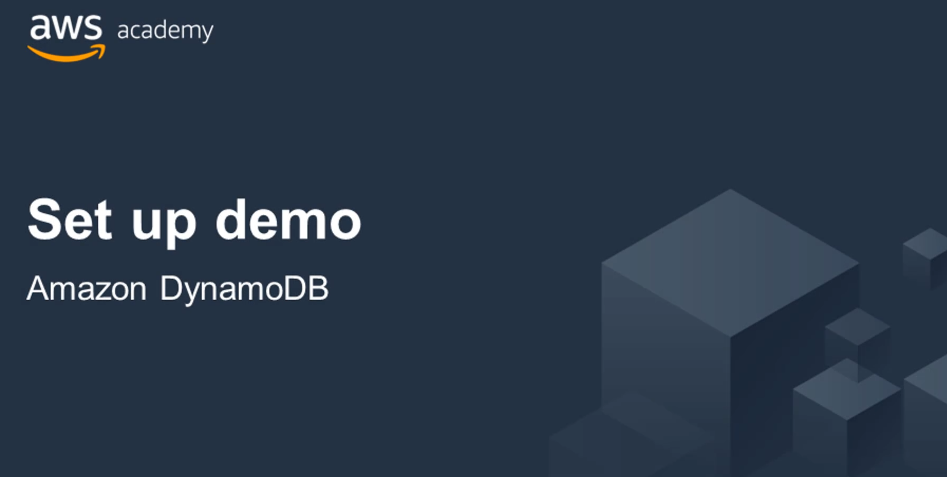
Recorded demo: Amazon DynamoDB console

Slide 11
Section 3: Amazon Redshift
Module 8: Databases

Slide 12

Amazon Redshift
Fast, fully managed data warehouse
Simple and cost-effective
Analyze petabytes of data by using standard SQL and existing business intelligence (BI) tools.
Amazon Redshift
Notes:
Example of Data Warehouse Tools: Teradata, Oracle Database, Apache Hive

Slide 13
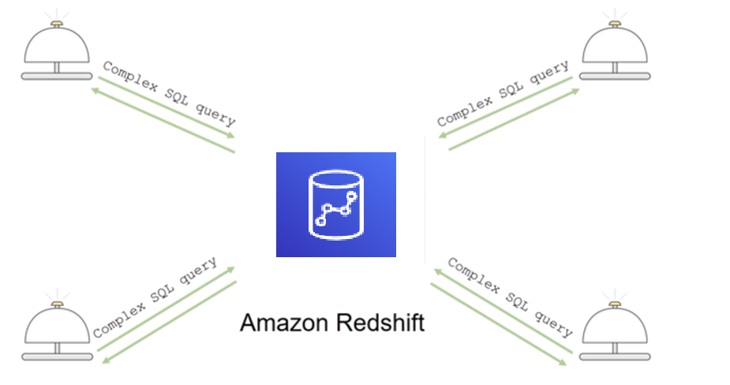
Introduction to Amazon Redshift

Slide 14



Parallel processing architecture
SQL Clients/BI tools
Amazon Redshift
Leader node
Dense compute
node
Dense compute nodes
Virtual Core
RAM
Local disk
Amazon DynamoDB
Amazon S3
Notes:
The leader node compiles code for individual elements of the plan and assigns the code to individual compute nodes.
The compute nodes run the compiled code and send intermediate results back to the leader node for final aggregation.
Example: Running Decision Trees, Random Forest, and Gradient Boosting in different nodes to get their f1-score (harmonic mean of precision and recall).

Slide 15
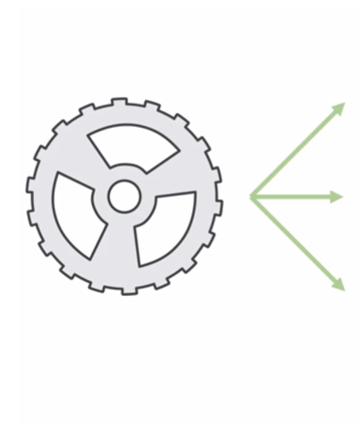
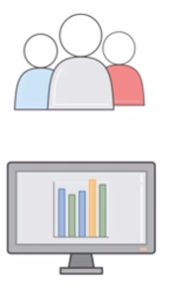
Automation and scaling
Manage
Monitor
Scale
Notes:
Data warehouse is managed in Amazon Redshift.
Scalability and security is intrinsic in Amazon Redshift.

Slide 16
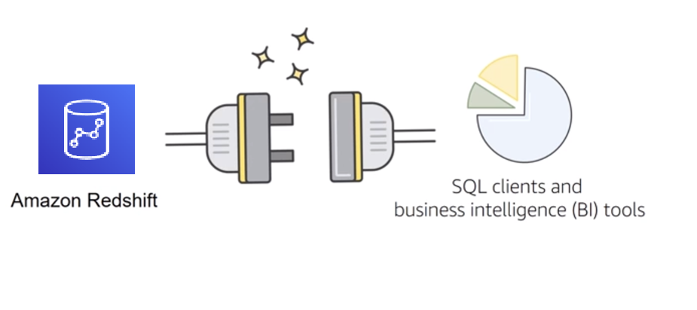
Compatibility
Notes:
Amazon Redshift is compatible with standard SQL, Java Database Connectivity (JDBC) and Open Database Connectivity (ODBC) connectors, which enable you to use the SQL clients and BI tools of your choice.

Slide 17

Amazon Redshift use cases (1 of 2)
Enterprise data warehouse (EDW)
Migrate at a pace that customers are comfortable with
Experiment without large upfront cost or commitment
Respond faster to business needs
Big data
Low price point for small customers
Managed service for ease of deployment and maintenance
Focus more on data and less on database management
Notes:
Near to customer premises

Slide 18

Amazon Redshift use cases (2 of 2)
Software as a service (SaaS)
Scale the data warehouse capacity as demand grows
Add analytic functionality to applications
Reduce hardware and software costs

Slide 19
Section 3 key takeaways
Amazon Redshift features:
Fast, fully managed data warehouse service
Easily scale with no downtime
Columnar storage and parallel processing architectures
Automatically and continuously monitors cluster
Encryption is built in

Slide 20
Thank you
All trademarks are the property of their owners.

